Slide 1

Smart Bins
Smart Garbage Management System
An Iot Application

Slide 2
Waste Generation in India
India: 0.14 million tonnes garbage generated
daily
World:4.7 million tonnes garbage generated
daily
6 million tonnes is expected to be generated by 2025

Slide 3





Current Scenario

Slide 4

Smart Solution

Slide 5

Smart
City
Objective

Slide 6



Vs
Traditional
Smart

Slide 7
Features Of Smart Bins
Solar Panel
Wireless connectivity(ESP8266)
Ultrasonic level Sensor
Display Monitor
Automatic compression Technique
Fire detection Sensor

Slide 8
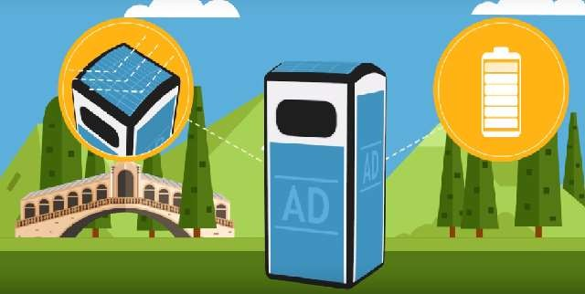


Solar panel
The sunlight collected by solar panel is converted into energy and stored into a battery

Slide 9
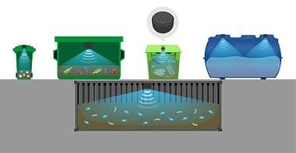
Read fill level
information
Ultrasonic level Sensor

Slide 10

Automatic compression

Slide 11
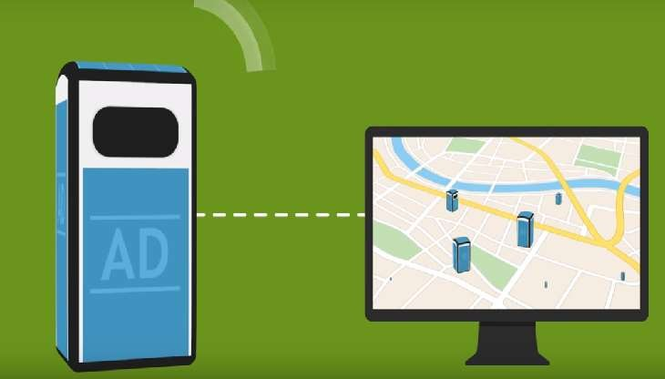
Wireless Connectivity

Slide 12
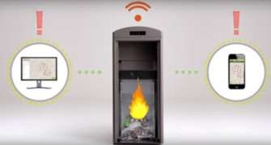
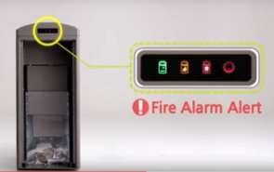
Fire Detection Sensor
Stop the fire by compression

Slide 13
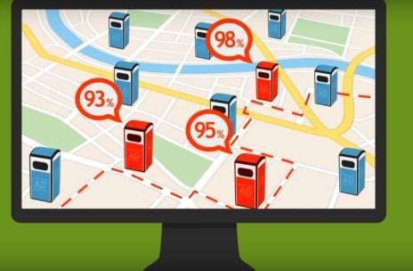
Real Time Analysis

Slide 14
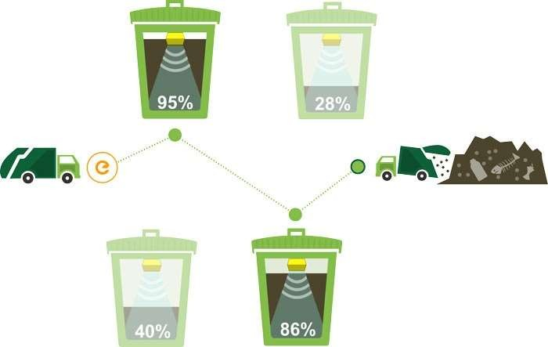
Optimized Path Route

Slide 15

START
Repeat
Check whether
dustbin is full or not
No
?
Yes
Send messages to the control room
Send cleaning vehicle for cleaning
Update status of the dustbin
Repeat

Slide 16
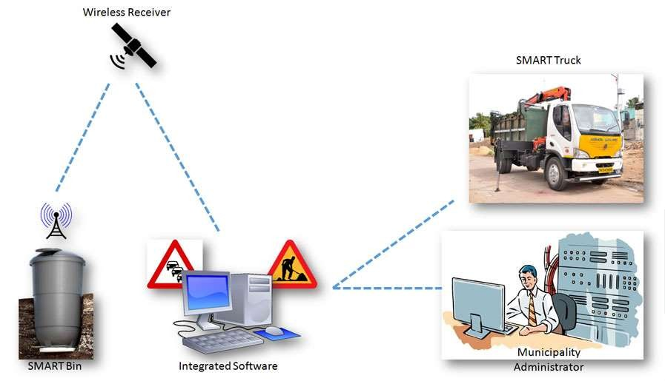

Slide 17

Advantages:
Reduce No of Trucks

Slide 18

Reduce Cost

Slide 19

Reduce fuel

Slide 20

Green city

